Slide 1
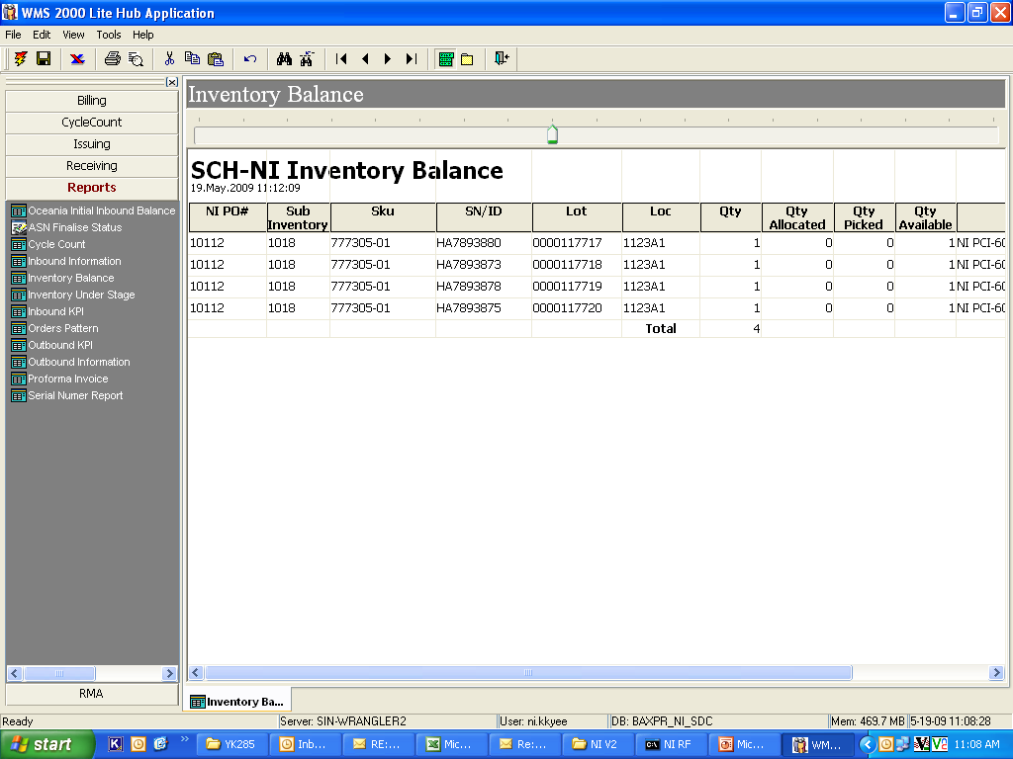
Inventory Report by Location

